Slide 1
Georgia Science Olympiad
Disease Detectives
Solve the Outbreak!

Slide 2
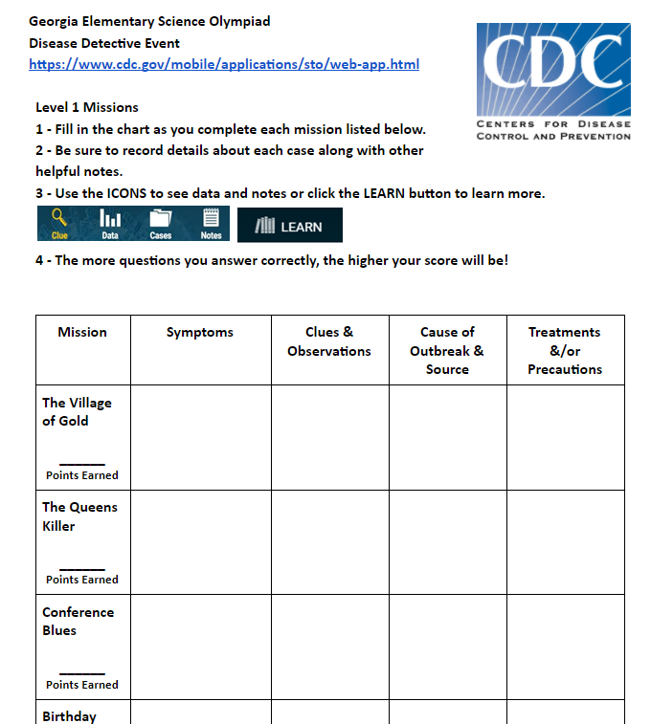
Directions
1 - Fill in the chart as you complete each mission listed below.
2 - Be sure to record details about each case along with other helpful notes.
3 - Use the ICONS to see data and notes or click the LEARN button to learn more.
4 - The more questions you answer correctly, the higher your score will be!

Slide 3
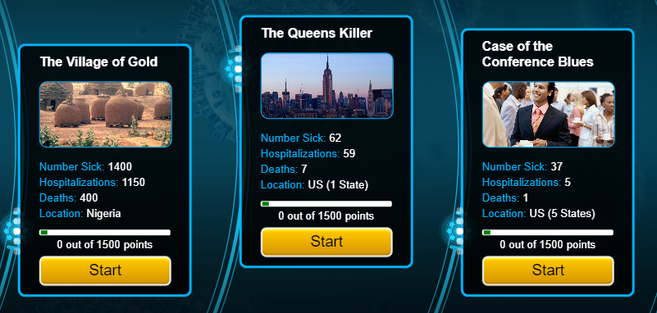
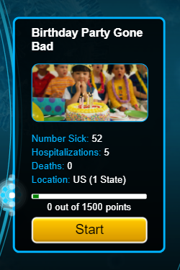
Getting Started
Go to this website: https://www.cdc.gov/mobile/applications/sto/web-app.html and click on one of the following cases.

Slide 4
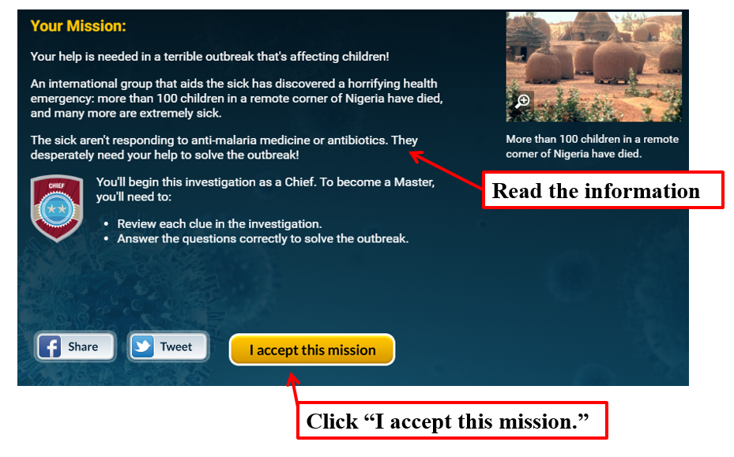
Case Overview- Provides the basic information you need to get started.

Slide 5
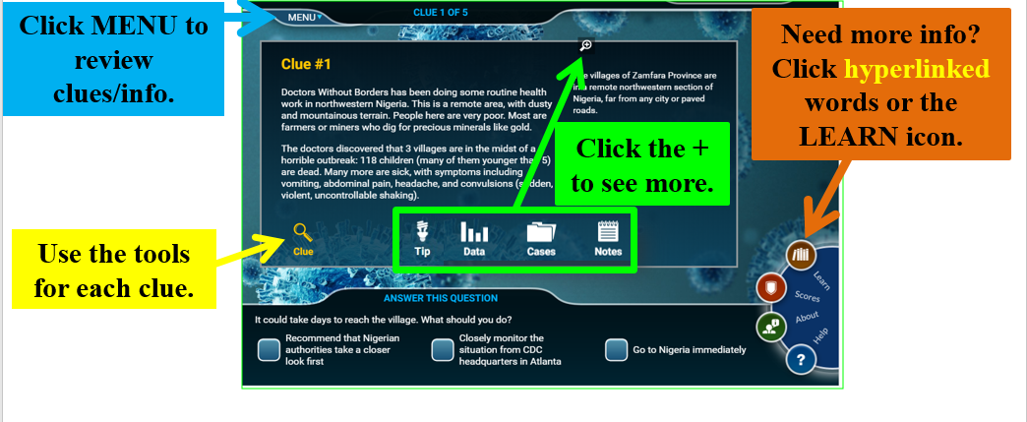
What next...
Read the 1st clue and write down any info you find the chart. Try to earn as many points as you can!

Slide 6
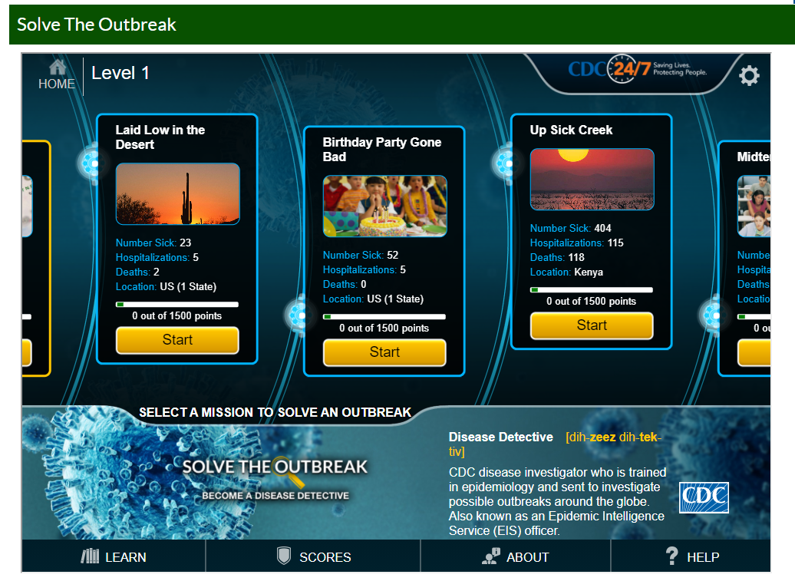
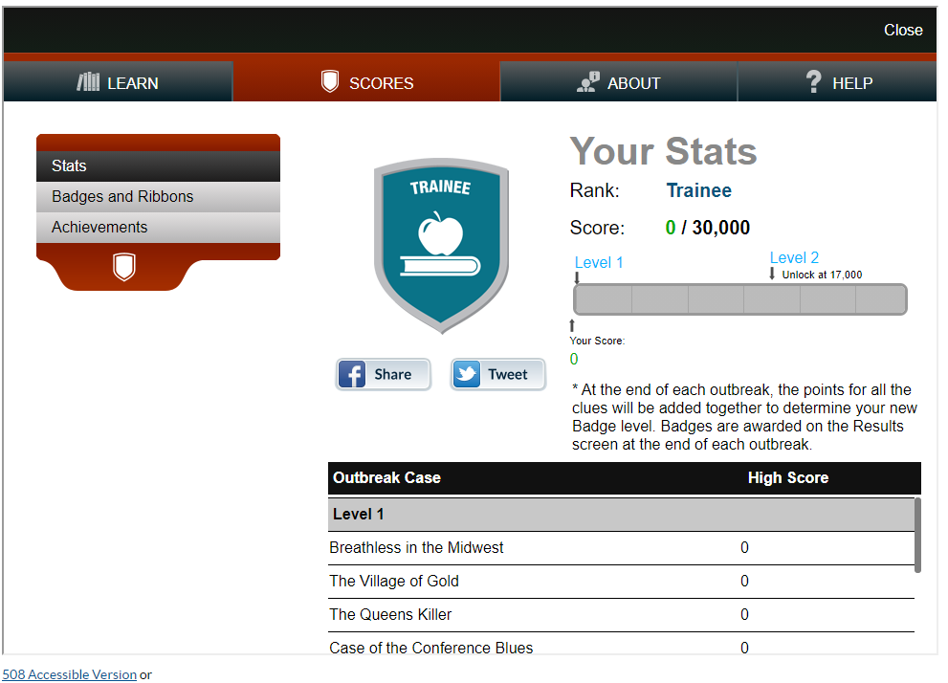
Earning Badges!
As you complete missions, you’ll earn badges and ribbons. Click on the “Scores” tab to see your rank, stats, badges, and ribbons.

